Slide 1
Relations
Chapter 9
Mr. SHOAIB RAZA

Slide 2
Chapter Summary
Relations and Their Properties
Representing Relations
Equivalence Relations

Slide 3
Relations and Their Properties
Section 9.1

Slide 4
Section Summary
Relations and Functions
Properties of Relations
Reflexive Relations
Symmetric and Antisymmetric Relations
Transitive Relations
Combining Relations

Slide 5
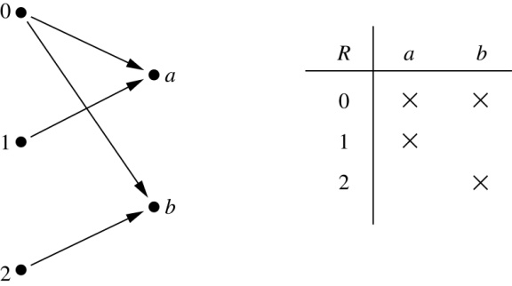
Binary Relations
Definition: A binary relation R from a set A to a set B is a subset R ⊆ A × B.
Example:
Let A = {0,1,2} and B = {a,b}
{(0, a), (0, b), (1,a) , (2, b)} is a relation from A to B.
We can represent relations from a set A to a set B graphically or using a table:
Relations are more general than functions. A function is a relation where exactly one element of B is related to each element of A.

Slide 6
Binary Relation on a Set
Definition: A binary relation R on a set A is a subset of A × A or a relation from A to A.
Example:
Suppose that A = {a,b,c}. Then R = {(a,a),(a,b), (a,c)} is a relation on A.
Let A = {1, 2, 3, 4}. The ordered pairs in the relation R = {(a,b) | a divides b} are
(1,1), (1, 2), (1,3), (1, 4), (2, 2), (2, 4), (3, 3), and (4, 4).

Slide 7
Binary Relation on a Set (cont.)
Question: How many relations are there on a set A?
Solution: Because a relation on A is the same thing as a subset of A ⨉ A, we count the subsets of A × A. Since A × A has n² elements when A has n elements, and a set with m elements has 2^{m} subsets, there are subsets of A × A. Therefore, there are relations on a set A.

Slide 8
Binary Relations on a Set (cont.)
Example: Consider these relations on the set of integers:
R₁ = {(a,b) | a ≤ b}, R₄ = {(a,b) | a = b},
R₂ = {(a,b) | a > b}, R₅ = {(a,b) | a = b + 1},
R₃ = {(a,b) | a = b or a = −b}, R₆ = {(a,b) | a + b ≤ 3}.
Which of these relations contain each of the pairs
(1,1), (1, 2), (2, 1), (1, −1), and (2, 2)?
Solution: Checking the conditions that define each relation, we see that the pair (1,1) is in R₁, R₃, R₄ , and R₆: (1,2) is in R₁ and R₆: (2,1) is in R₂, R₅, and R₆: (1, −1) is in R₂, R₃, and R₆ : (2,2) is in R₁, R₃, and R₄.
Note that these relations are on an infinite set and each of these relations is an infinite set.

Slide 9
Reflexive Relations
Definition: R is reflexive iff (a,a) ∊ R for every element a ∊ A. Written symbolically, R is reflexive if and only if
∀x[x∊U ⟶ (x,x) ∊ R]
Example: The following relations on the integers are reflexive:
R₁ = {(a,b) | a ≤ b},
R₃ = {(a,b) | a = b or a = −b},
R₄ = {(a,b) | a = b}.
The following relations are not reflexive:
R₂ = {(a,b) | a > b} (note that 3 ≯ 3),
R₅ = {(a,b) | a = b + 1} (note that 3 ≠3 + 1),
R₆ = {(a,b) | a + b ≤ 3} (note that 4 + 4 ≰ 3).
If A = ∅ then the empty relation is reflexive vacuously. That is the empty relation on an empty set is reflexive!

Slide 10
Symmetric Relations
Definition: R is symmetric iff (b,a) ∊ R whenever (a,b) ∊ R for all a,b ∊ A. Written symbolically, R is symmetric if and only if
∀x∀y [(x,y) ∊R ⟶ (y,x) ∊ R]
Example: The following relations on the integers are symmetric:
R₃ = {(a,b) | a = b or a = −b},
R₄ = {(a,b) | a = b},
R₆ = {(a,b) | a + b ≤ 3}.
The following are not symmetric:
R₁ = {(a,b) | a ≤ b} (note that 3 ≤ 4, but 4 ≰ 3),
R₂ = {(a,b) | a > b} (note that 4 > 3, but 3 ≯ 4),
R₅ = {(a,b) | a = b + 1} (note that 4 = 3 + 1, but 3 ≠4 + 1).

Slide 11
Antisymmetric Relations
Definition:A relation R on a set A such that for all a,b ∊ A if (a,b) ∊ R and (b,a) ∊ R, then a = b is called antisymmetric. Written symbolically, R is antisymmetric if and only if
∀x∀y [(x,y) ∊R ∧ (y,x) ∊ R ⟶ x = y]
Example: The following relations on the integers are antisymmetric:
R₁ = {(a,b) | a ≤ b},
R₂ = {(a,b) | a > b},
R₄ = {(a,b) | a = b},
R₅ = {(a,b) | a = b + 1}.
The following relations are not antisymmetric:
R₃ = {(a,b) | a = b or a = −b}
(note that both (1,−1) and (−1,1) belong to R₃),
R₆ = {(a,b) | a + b ≤ 3} (note that both (1,2) and (2,1) belong to R₆).
For any integer, if a a ≤ b and a ≤ b , then a = b.

Slide 12
Transitive Relations
Definition: A relation R on a set A is called transitive if whenever (a,b) ∊ R and (b,c) ∊ R, then (a,c) ∊ R, for all a,b,c ∊ A. Written symbolically, R is transitive if and only if
∀x∀y ∀z[(x,y) ∊R ∧ (y,z) ∊ R ⟶ (x,z) ∊ R ]
Example: The following relations on the integers are transitive:
R₁ = {(a,b) | a ≤ b},
R₂ = {(a,b) | a > b},
R₃ = {(a,b) | a = b or a = −b},
R₄ = {(a,b) | a = b}.
The following are not transitive:
R₅ = {(a,b) | a = b + 1} (note that both (3,2) and (4,3) belong to R₅, but not (3,3)),
R₆ = {(a,b) | a + b ≤ 3} (note that both (2,1) and (1,2) belong to R₆, but not (2,2)).
For every integer, a ≤ b
and b ≤ c, then b ≤ c.

Slide 13
Combining Relations
Given two relations R₁ and R₂, we can combine them using basic set operations to form new relations such as R₁ ∪ R₂, R₁ ∩ R₂, R₁ − R₂, and R₂ − R₁.
Example: Let A = {1,2,3} and B = {1,2,3,4}. The relations R₁ = {(1,1),(2,2),(3,3)} and R₂ = {(1,1),(1,2),(1,3),(1,4)} can be combined using basic set operations to form new relations:
R₁ ∪ R₂ ={(1,1),(1,2),(1,3),(1,4),(2,2),(3,3)}
R₁ ∩ R₂ ={(1,1)}
R₁ − R₂ ={(2,2),(3,3)}
R₂ − R₁ ={(1,2),(1,3),(1,4)}

Slide 14
Composition
Definition: Suppose
R₁ is a relation from a set A to a set B.
R₂ is a relation from B to a set C.
Then the composition (or composite) of R₂ with R₁, is a relation from A to C where
if (x,y) is a member of R₁ and (y,z) is a member of R₂, then (x,z) is a member of R₂∘ R₁.

Slide 15
Representing the Composition of a Relation
R₁
R₂
w
m
a
x
n
b
y
o
c
p
z
R₁∘ R₂ = {(b,D),(b,B)}

Slide 16
Representing Relations
Section 9.3

Slide 17
Section Summary
Representing Relations using Matrices
Representing Relations using Digraphs

Slide 18
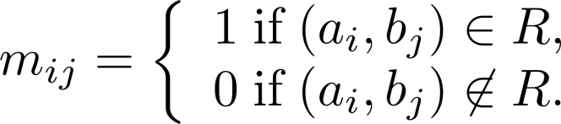
Representing Relations Using Matrices
A relation between finite sets can be represented using a zero-one matrix.
Suppose R is a relation from A = {a₁, a₂, …, a_{m}} to B = {b₁, b₂, …, b_{n}}.
The elements of the two sets can be listed in any particular arbitrary order. When A = B, we use the same ordering.
The relation R is represented by the matrix M_{R} = [m_{ij}], where
The matrix representing R has a 1 as its (i,j) entry when a_{i} is related to b_{j} and a 0 if a_{i} is not related to b_{j}.

Slide 19
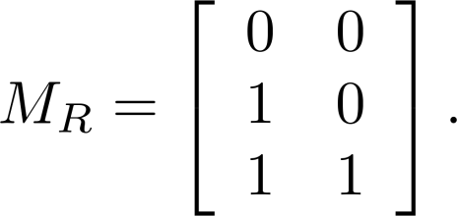
Examples of Representing Relations Using Matrices
Example 1: Suppose that A = {1,2,3} and B = {1,2}. Let R be the relation from A to B containing (a,b) if a ∈ A, b ∈ B, and a > b. What is the matrix representing R (assuming the ordering of elements is the same as the increasing numerical order)?
Solution: Because R = {(2,1), (3,1),(3,2)}, the matrix is

Slide 20
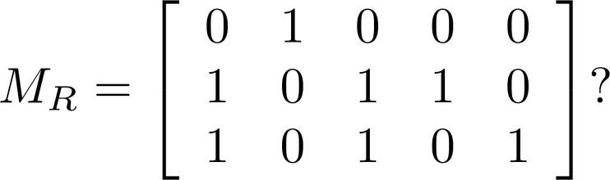
Examples of Representing Relations Using Matrices (cont.)
Example 2: Let A = {a₁,a₂, a₃} and B = {b₁,b₂, b₃,b₄, b₅}. Which ordered pairs are in the relation R represented by the matrix
Solution: Because R consists of those ordered pairs (a_{i},b_{j}) with m_{ij} = 1, it follows that:
R = {(a₁, b₂), (a₂, b₁),(a₂, b₃), (a₂, b₄),(a₃, b₁), {(a₃, b₃), (a₃, b₅)}.

Slide 21
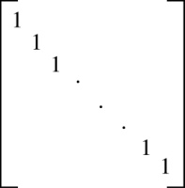
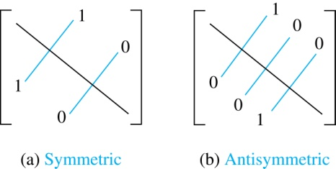
Matrices of Relations on Sets
If R is a reflexive relation, all the elements on the main diagonal of M_{R} are equal to 1.
R is a symmetric relation, if and only if m_{ij} = 1 whenever m_{ji} = 1. R is an antisymmetric relation, if and only if m_{ij} = 0 or m_{ji} = 0 when i≠ j.

Slide 22
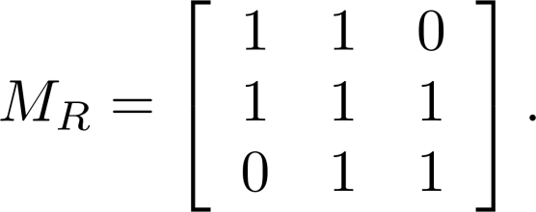
Example of a Relation on a Set
Example 3: Suppose that the relation R on a set is represented by the matrix
Is R reflexive, symmetric, and/or antisymmetric?
Solution: Because all the diagonal elements are equal to 1, R is reflexive. Because M_{R} is symmetric, R is symmetric and not antisymmetric because both m_{1,2} and m_{2,1} are 1.

Slide 23
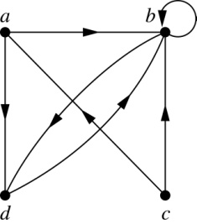
Representing Relations Using Digraphs
Definition: A directed graph, or digraph, consists of a set V of vertices (or nodes) together with a set E of ordered pairs of elements of V called edges (or arcs). The vertex a is called the initial vertex of the edge (a,b), and the vertex b is called the terminal vertex of this edge.
An edge of the form (a,a) is called a loop.
Example 7: A drawing of the directed graph with vertices a, b, c, and d, and edges (a, b), (a, d), (b, b), (b, d), (c, a), (c, b), and (d, b) is shown here.

Slide 24
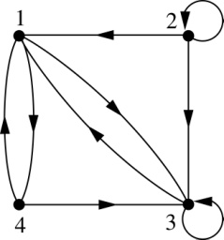
Examples of Digraphs Representing Relations
Example 8: What are the ordered pairs in the relation
represented by this directed graph?
Solution: The ordered pairs in the relation are
(1, 3), (1, 4), (2, 1), (2, 2), (2, 3), (3, 1), (3, 3), (4, 1), and (4, 3)

Slide 25
Determining which Properties a Relation has from its Digraph
Reflexivity: A loop must be present at all vertices in the graph.
Symmetry: If (x,y) is an edge, then so is (y,x).
Antisymmetry: If (x,y) with x ≠ y is an edge, then (y,x) is not an edge.
Transitivity: If (x,y) and (y,z) are edges, then so is (x,z).

Slide 26
Determining which Properties a Relation has from its Digraph – Example 1
a
b
c
d
Reflexive? No, not every vertex has a loop
Symmetric? Yes (trivially), there is no edge from one vertex to another
Antisymmetric? Yes (trivially), there is no edge from one vertex
to another
Transitive? Yes, (trivially) since there is no edge from one vertex to another

Slide 27
Determining which Properties a Relation has from its Digraph – Example 2
a
b
c
d
Reflexive? No, there are no loops
Symmetric? No, there is an edge from a to b, but not from b to a
Antisymmetric? No, there is an edge from d to b and b to d
Transitive? No, there are edges from a to c and from c to b,
but there is no edge from a to d

Slide 28
Determining which Properties a Relation has from its Digraph – Example 3
a
b
c
d
Reflexive? No, there are no loops
Symmetric? No, for example, there is no edge from c to a
Antisymmetric? Yes, whenever there is an edge from one
vertex to another, there is not one going back
Transitive? No, there is no edge from a to b

Slide 29
Determining which Properties a Relation has from its Digraph – Example 4
b
a
c
d
Reflexive? No, there are no loops
Symmetric? No, for example, there is no edge from d to a
Antisymmetric? Yes, whenever there is an edge from one vertex
to another, there is not one going back
Transitive? Yes (trivially), there are no two edges where the first
edge ends at the vertex where the second edge begins

Slide 30
Example of the Powers of a Relation
b
a
b
a
d
c
d
c
R
R²
a
b
a
b
d
c
d
c
R⁴
R³
The pair (x,y) is in R^{n} if there is a path of length n from x to y in R
(following the direction of the arrows).

Slide 31
Equivalence Relations
Section 9.5

Slide 32
Equivalence Relations
Definition 1: A relation on a set A is called an equivalence relation if it is reflexive, symmetric, and transitive.
Definition 2: Two elements a, and b that are related by an equivalence relation are called equivalent. The notation a ∼ b is often used to denote that a and b are equivalent elements with respect to a particular equivalence relation.

Slide 33
Strings
Example: Suppose that R is the relation on the set of strings of English letters such that aRb if and only if l(a) = l(b), where l(x) is the length of the string x. Is R an equivalence relation?
Solution: Show that all of the properties of an equivalence relation hold.
Reflexivity: Because l(a) = l(a), it follows that aRa for all strings a.
Symmetry: Suppose that aRb. Since l(a) = l(b), l(b) = l(a) also holds and bRa.
Transitivity: Suppose that aRb and bRc. Since l(a) = l(b),and l(b) = l(c), l(a) = l(a) also holds and aRc.

Slide 34
Congruence Modulo m
Example: Let m be an integer with m > 1. Show that the relation
R = {(a,b) | a ≡ b (mod m)}
is an equivalence relation on the set of integers.
Solution: Recall that a ≡ b (mod m) if and only if m divides a − b.
Reflexivity: a ≡ a (mod m) since a − a = 0 is divisible by m since 0 = 0 ∙ m.
Symmetry: Suppose that a ≡ b (mod m). Then a − b is divisible by m, and so a − b = km, where k is an integer. It follows that b − a = (− k) m, so b ≡ a (mod m).
Transitivity: Suppose that a ≡ b (mod m) and b ≡ c (mod m). Then m divides both a − b and b − c. Hence, there are integers k and l with a − b = km and b − c = lm. We obtain by adding the equations:
a − c = (a − b) + (b − c) = km + lm = (k + l) m.
Therefore, a ≡ c (mod m).

Slide 35
Divides
Example: Show that the “divides” relation on the set of positive integers is not an equivalence relation.
Solution: The properties of reflexivity, and transitivity do hold, but there relation is not transitive. Hence, “divides” is not an equivalence relation.
Reflexivity: a ∣ a for all a.
Not Symmetric: For example, 2 ∣ 4, but 4 ∤ 2. Hence, the relation is not symmetric.
Transitivity: Suppose that a divides b and b divides c. Then there are positive integers k and l such that b = ak and c = bl. Hence, c = a(kl), so a divides c. Therefore, the relation is transitive.

Slide 36
Equivalence Classes
Definition 3: Let R be an equivalence relation on a set A. The set of all elements that are related to an element a of A is called the equivalence class of a. The equivalence class of a with respect to R is denoted by [a]_{R}.
When only one relation is under consideration, we can write [a], without the subscript R, for this equivalence class.
Note that [a]_{R} = {s|(a,s) ∈ R}.
If b ∈ [a]_{R}, then b is called a representative of this equivalence class. Any element of a class can be used as a representative of the class.
The equivalence classes of the relation congruence modulo m are called the congruence classes modulo m. The congruence class of an integer a modulo m is denoted by [a]_{m}, so [a]_{m} = {…, a−2m, a−m, a+2m, a+2m, … }. For example,
[0]₄ = {…, −8, −4 , 0, 4 , 8 , …} [1]₄ = {…, −7, −3 , 1, 5 , 9 , …}
[2]₄ = {…, −6, −2 , 2, 6 , 10 , …} [3]₄ = {…, −5, −1 , 3, 7 , 11 , …}

Slide 37
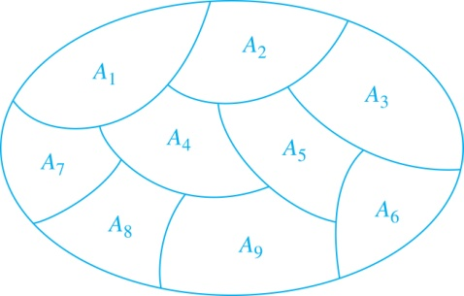
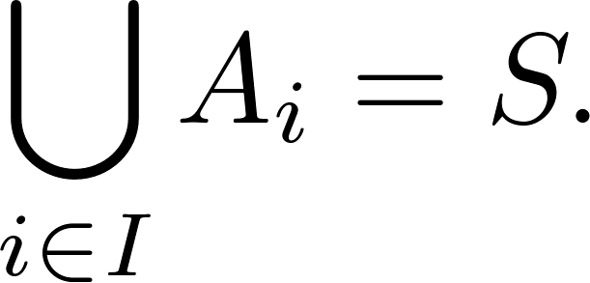
Partition of a Set
Definition: A partition of a set S is a collection of disjoint nonempty subsets of S that have S as their union. In other words, the collection of subsets A_{i}, where i ∈ I (where I is an index set), forms a partition of S if and only if
A_{i} ≠ ∅ for i ∈ I,
A_{i} ∩ A_{j}=∅ when i ≠ j,
and
A Partition of a Set

Slide 38
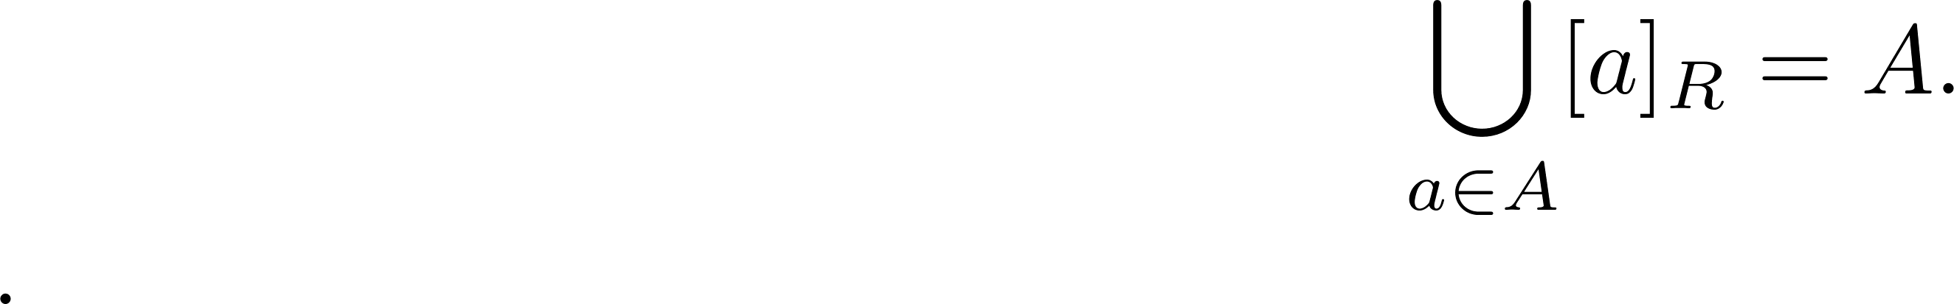
An Equivalence Relation Partitions a Set
Let R be an equivalence relation on a set A. The union of all the equivalence classes of R is all of A, since an element a of A is in its own equivalence class [a]_{R}. In other words,
From Theorem 1, it follows that these equivalence classes are either equal or disjoint, so [a]_{R} ∩[b]_{R}=∅ when [a]_{R} ≠ [b]_{R}.
Therefore, the equivalence classes form a partition of A, because they split A into disjoint subsets.

Slide 39
Basic Structures: Sets and Functions
Chapter 2
Shoaib Raza

Slide 40
Functions
Section 2.3

Slide 41
Section Summary
Definition of a Function.
Domain, Codomain
Image, Pre image
Injection, Surjection, Bijection
Inverse Function
Function Composition
Graphing Functions
Floor, Ceiling, Factorial

Slide 42
Functions
Definition: Let A and B be nonempty sets. A function f from A to B, denoted f: A → B is an assignment of each element of A to exactly one element of B. We write f(a) = b if b is the unique element of B assigned by the function f to the element a of A.
Functions are sometimes
called mappings or
transformations.
Students
Grades
A
Carlota Rodriguez
B
Sandeep Patel
C
Jalen Williams
D
F
Kathy Scott

Slide 43
Functions
A function f: A → B can also be defined as a subset of A×B (a relation). This subset is restricted to be a relation where no two elements of the relation have the same first element.
Specifically, a function f from A to B contains one, and only one ordered pair (a, b) for every element a∈ A.
and

Slide 44
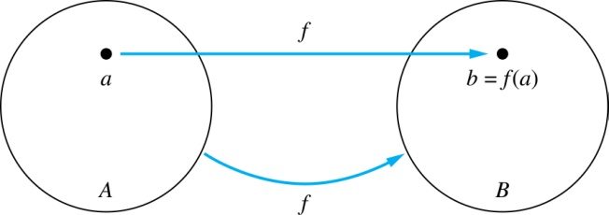
Functions
Given a function f: A → B:
We say f maps A to B or
f is a mapping from A to B.
A is called the domain of f.
B is called the codomain of f.
If f(a) = b,
then b is called the image of a under f.
a is called the preimage of b.
The range of f is the set of all images of points in A under f. We denote it by f(A).
Two functions are equal when they have the same domain, the same codomain and map each element of the domain to the same element of the codomain.

Slide 45
Equal Functions
Two functions are equal when they
have the same domain,
have the same codomain,
map each element of their common domain to the same element in their common codomain.
If we change either the domain or the codomain of a function, then we obtain a different function.
If we change the mapping of elements, then we also obtain a different function.

Slide 46
Representing Functions
Functions may be specified in different ways:
An explicit statement of the assignment.
Students and grades example.
A formula.
f(x) = x + 1
A computer program.
A Java program that when given an integer n, produces the nth Fibonacci Number (covered in the next section and also inChapter 5).

Slide 47
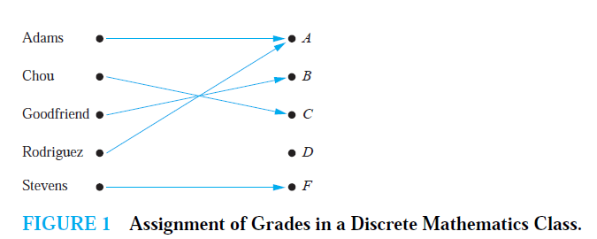
Activity Time
What are the domain, codomain, and range of the following function

Slide 48
Solution
Let G be the function that assigns a grade to a student in our discrete mathematics class.
Note that G(Adams) = A, for instance.
The domain of G is the set {Adams, Chou, Goodfriend, Rodriguez, Stevens},
The codomain is the set {A,B,C,D,F}.
The range of G is the set {A,B,C, F},

Slide 49
Questions
z
A
B
f(a) = ?
The image of d is ?
z
a
x
The domain of f is ?
A
b
y
The codomain of f is ?
B
c
d
z
The preimage of y is ?
b
f(A) = ?
The preimage(s) of z is (are) ?
{a,c,d}

Slide 50
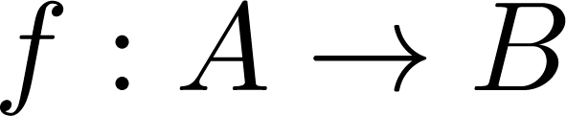
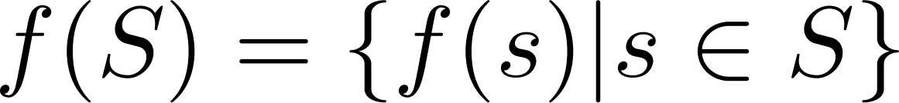
Question on Functions and Sets
If and S is a subset of A, then
A
B
f {a,b,c,} is ?
{y,z}
a
x
f {c,d} is ?
b
{z}
y
c
d
z

Slide 51
Injections
Definition: A function f is said to be one-to-one , or injective, if and only if f(a) = f(b) implies that a = b for all a and b in the domain of f. A function is said to be an injection if it is one-to-one.
A
B
a
x
v
b
y
c
z
d
w

Slide 52

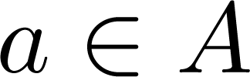
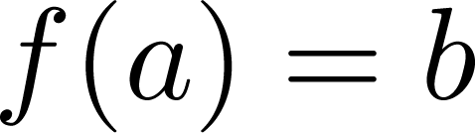
Surjections
Definition: A function f from A to B is called onto or surjective, if and only if for every element there is an element with . A function f is called a surjection if it is onto.
A
B
a
x
b
y
c
z
d

Slide 53
Bijections
Definition: A function f is a one-to-one correspondence, or a bijection, if it is both one-to-one and onto (surjective and injective).
A
B
a
x
b
y
c
d
z
w

Slide 54
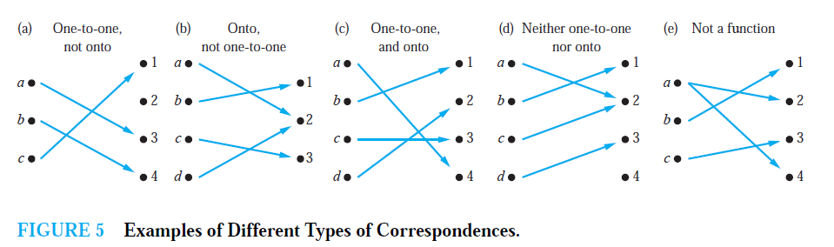

Slide 55
real-valued
A function is called real-valued if its codomain is the set of real numbers.
Let f1 and f2 be functions from A to R.
Then f1 + f2 and f1f2 are also functions from A to R defined for all x ∈ A by
(f1 + f2)(x) = f1(x) + f2(x),
(f1f2)(x) = f1(x)f2(x).

Slide 56
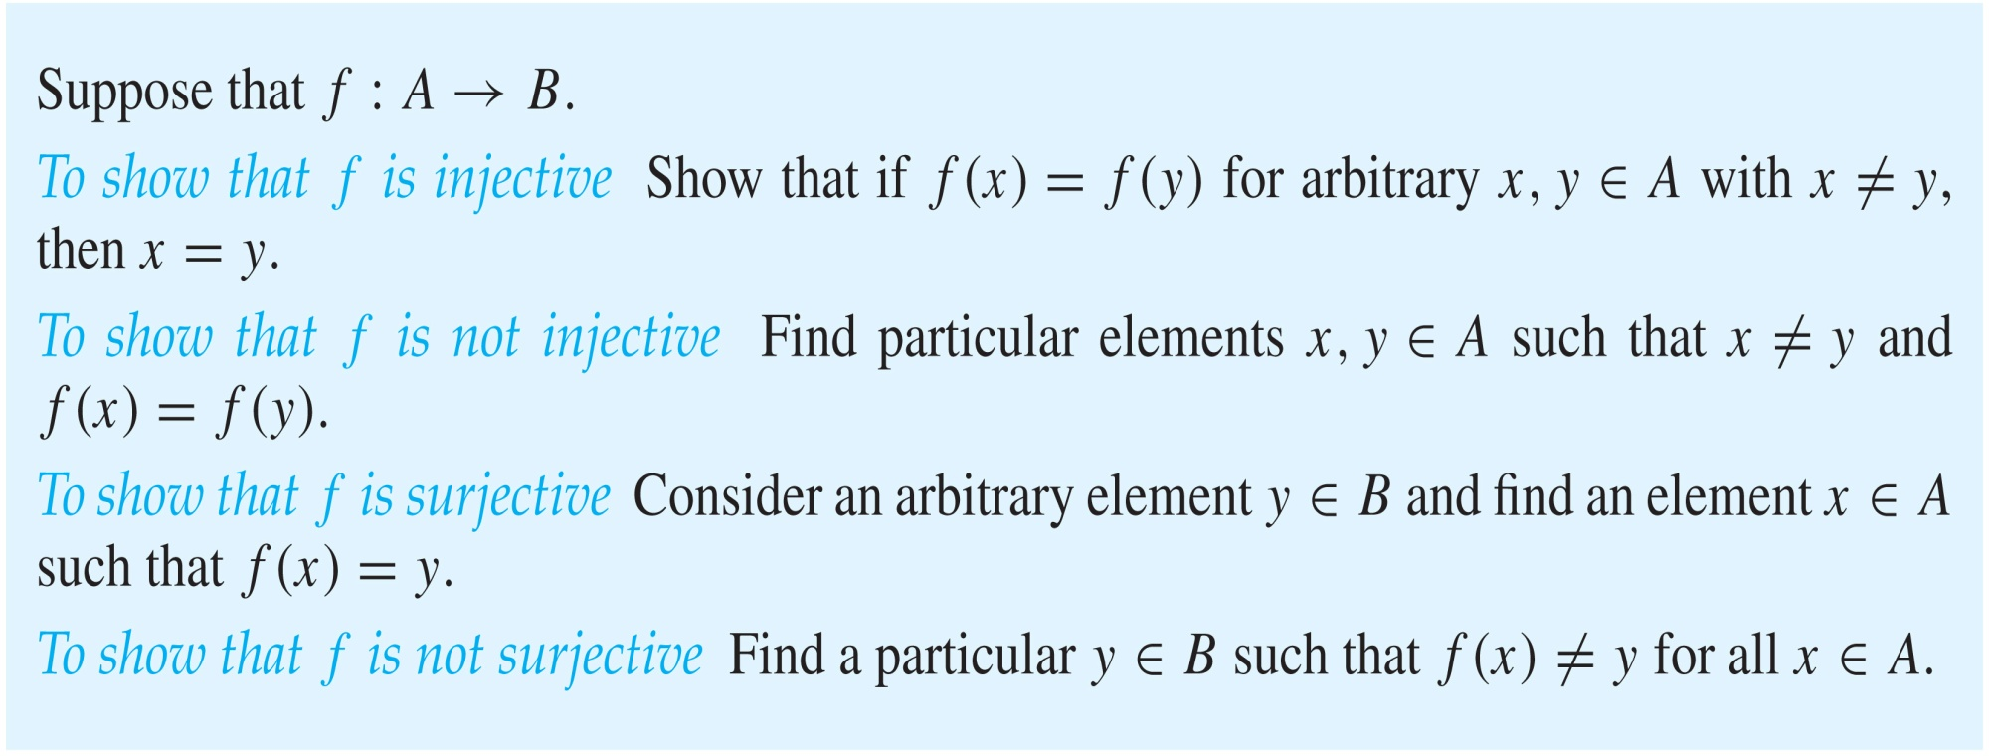
Showing that f is one-to-one or onto

Slide 57
Showing that f is one-to-one or onto
Example 1: Let f be the function from {a,b,c,d} to {1,2,3} defined by f(a) = 3, f(b) = 2, f(c) = 1, and f(d) = 3. Is f an onto function?
Solution: Yes, f is onto since all three elements of the codomain are images of elements in the domain. If the codomain were changed to {1,2,3,4}, f would not be onto.

Slide 58
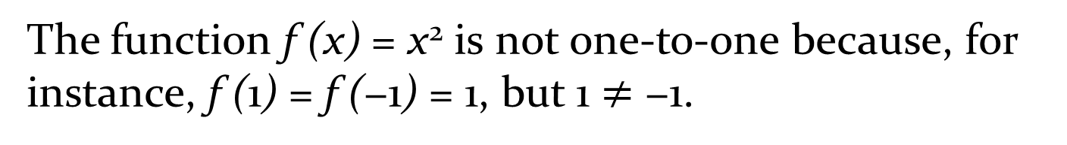
Example 2:
Determine whether the function f (x) = x² from the set of integers to the set of integers is one-to-one.
The function f (x) = x² is not one-to-one because, for instance, f (1) = f (−1) = 1, but 1 $≠$ −1.

Slide 59
Increasing/ decreasing functions
A function f whose domain and codomain are subsets of the set of real numbers is called increasing if f (x) ≤ f (y), and strictly increasing if f(x) < f(y), whenever x < y and x and y are in the domain of f.
Similarly, f is called decreasing if f (x) ≥ f (y), and strictly decreasing if f(x) > f(y), whenever x < y and x and y are in the domain of f.

Slide 60
Increasing/ decreasing functions
A function f is
increasing if ∀x∀y(x < y → f (x) ≤ f (y)),
strictly increasing if ∀x∀y(x < y → f (x) < f (y)),
decreasing if ∀x∀y(x < y → f (x) ≥ f (y)),
strictly decreasing if ∀x∀y(x < y → f (x) > f (y)),
where the universe of discourse is the domain of f.

Slide 61
Relationship with one-to-one
a function that is either strictly increasing or strictly decreasing must be one-to-one.
a function that is increasing, but not strictly increasing, or decreasing, but not strictly decreasing, is not one-to-one.

Slide 62
The identity function
Let A be a set. The identity function on A is the function ιA : A → A, where
ιA(x) = x
for all x ∈ A.
The function ιA is one-to-one and onto, so it is a bijection.

Slide 63
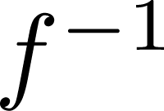
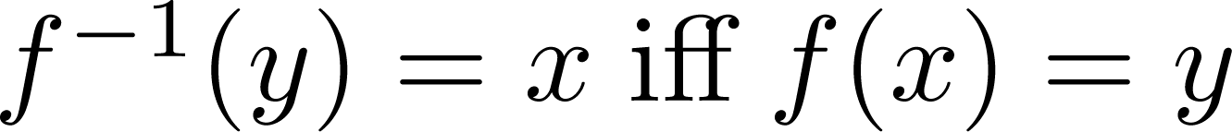
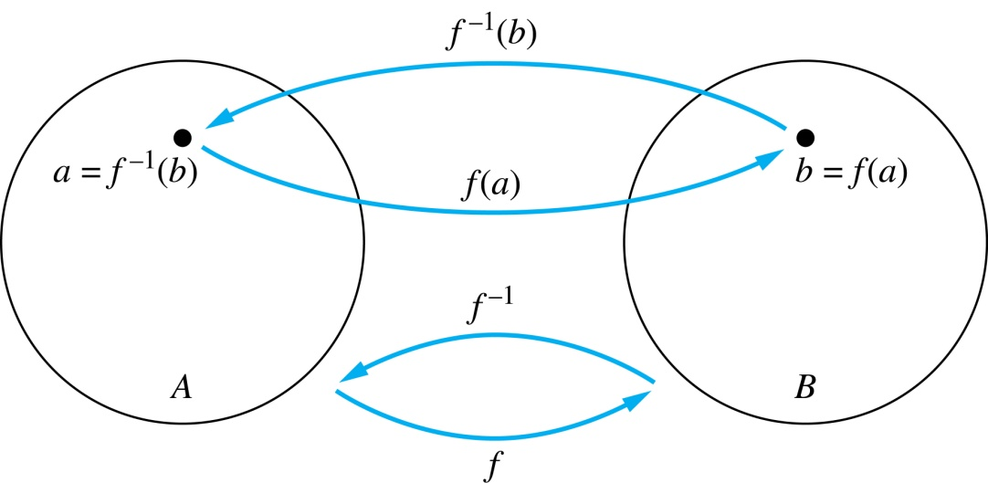
Inverse Functions
Definition: Let f be a bijection from A to B. Then the inverse of f, denoted , is the function from B to A defined as
No inverse exists unless f is a bijection. Why?

Slide 64
Inverse Functions
A
B
A
B
f
a
V
V
a
b
b
W
W
c
c
d
X
X
d
Y
Y

Slide 65
Questions
Example 1: Let f be the function from {a,b,c} to {1,2,3} such that f(a) = 2, f(b) = 3, and f(c) = 1. Is f invertible and if so what is its inverse?
Solution: The function f is invertible because it is a one-to-one correspondence. The inverse function f⁻¹ reverses the correspondence given by f, so f⁻¹ (1) = c, f⁻¹ (2) = a, and f⁻¹ (3) = b.

Slide 66
Questions
Example 2: Let f: Z → Z be such that f(x) = x + 1. Is f invertible, and if so, what is its inverse?
Solution: The function f is invertible because it is a one-to-one correspondence. The inverse function f⁻¹ reverses the correspondence so f⁻¹ (y) = y – 1.

Slide 67
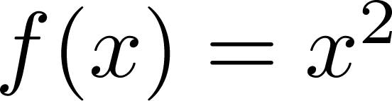
Questions
Example 3: Let f: R → R be such that . Is f invertible, and if so, what is its inverse?
Solution: The function f is not invertible because it is not one-to-one .

Slide 68
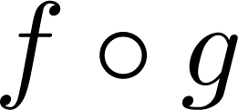
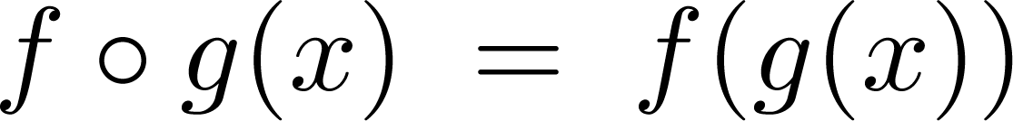
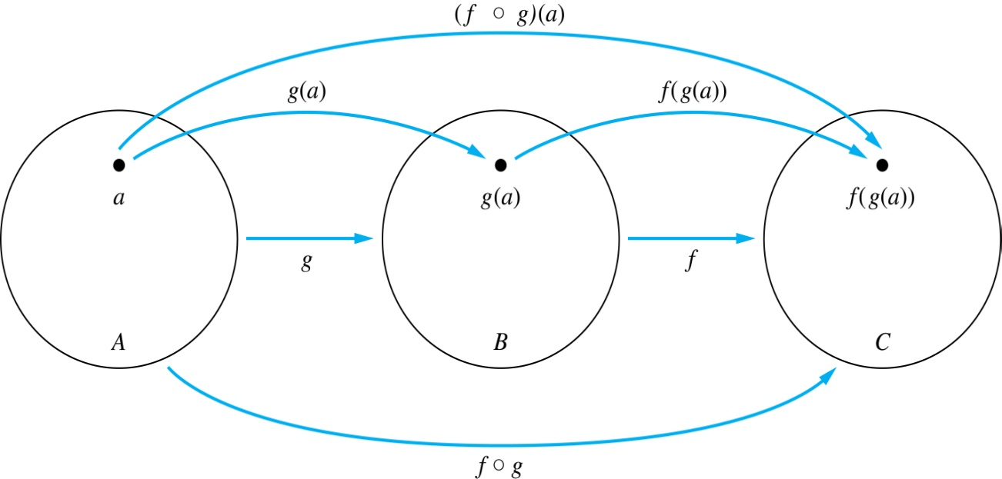
Composition
Definition: Let f: B → C, g: A → B. The composition of f with g, denoted is the function from A to C defined by

Slide 69
Composition
A
g
B
f
C
A
C
V
a
a
h
h
b
i
b
W
i
c
c
X
j
d
d
j
Y

Slide 70
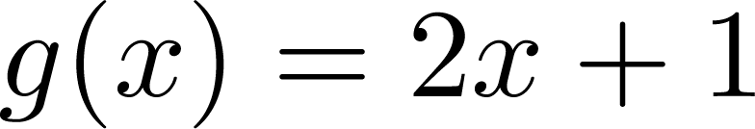
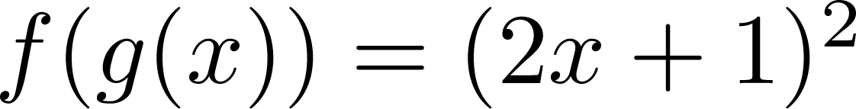
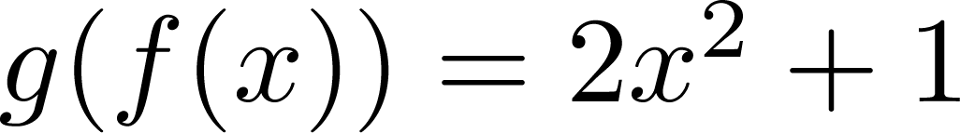
Composition
Example 1: If and , then
and

Slide 71
Composition Questions
Example 2: Let g be the function from the set {a,b,c} to itself such that g(a) = b, g(b) = c, and g(c) = a. Let f be the function from the set {a,b,c} to the set {1,2,3} such that f(a) = 3, f(b) = 2, and f(c) = 1.
What is the composition of f and g, and what is the composition of g and f.
Solution: The composition f∘g is defined by
f∘g (a)= f(g(a)) = f(b) = 2.
f∘g (b)= f(g(b)) = f(c) = 1.
f∘g (c)= f(g(c)) = f(a) = 3.
Note that g∘f is not defined, because the range of f is not a subset of the domain of g.

Slide 72
Composition Questions
Example 2: Let f and g be functions from the set of integers to the set of integers defined by f(x) = 2x + 3 and g(x) = 3x + 2.
What is the composition of f and g, and also the composition of g and f ?
Solution:
f∘g (x)= f(g(x)) = f(3x + 2) = 2(3x + 2) + 3 = 6x + 7
g∘f (x)= g(f(x)) = g(2x + 3) = 3(2x + 3) + 2 = 6x + 11

Slide 73
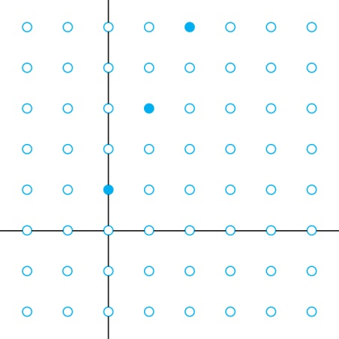
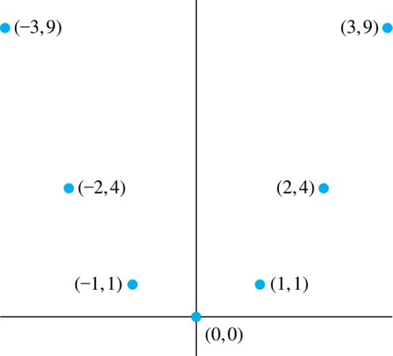
Graphs of Functions
Let f be a function from the set A to the set B. The graph of the function f is the set of ordered pairs {(a,b) | a ∈A and f(a) = b}.
Graph of f(n) = 2n + 1
from Z to Z
Graph of f(x) = x²
from Z to Z

Slide 74
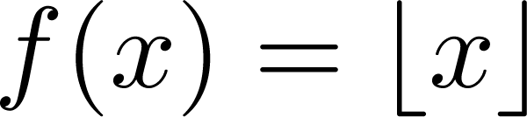
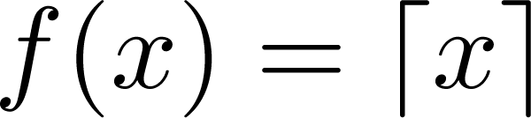
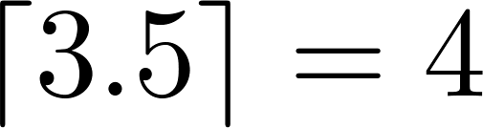
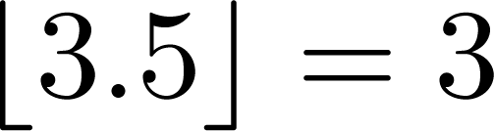
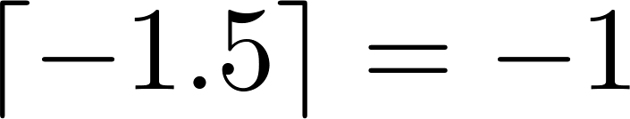
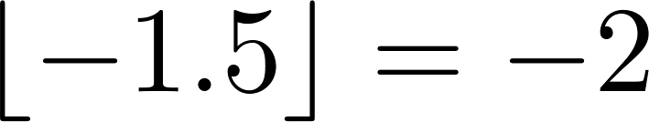
Some Important Functions
The floor function, denoted
is the largest integer less than or equal to x.
The ceiling function, denoted
is the smallest integer greater than or equal to x
Example:

Slide 75
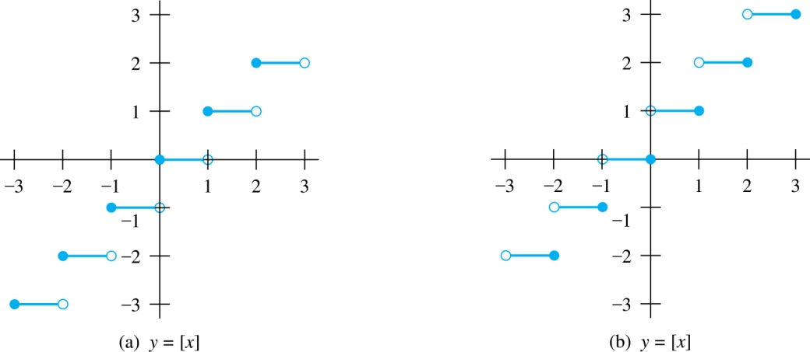
Floor and Ceiling Functions
Graph of (a) Floor and (b) Ceiling Functions

Slide 76
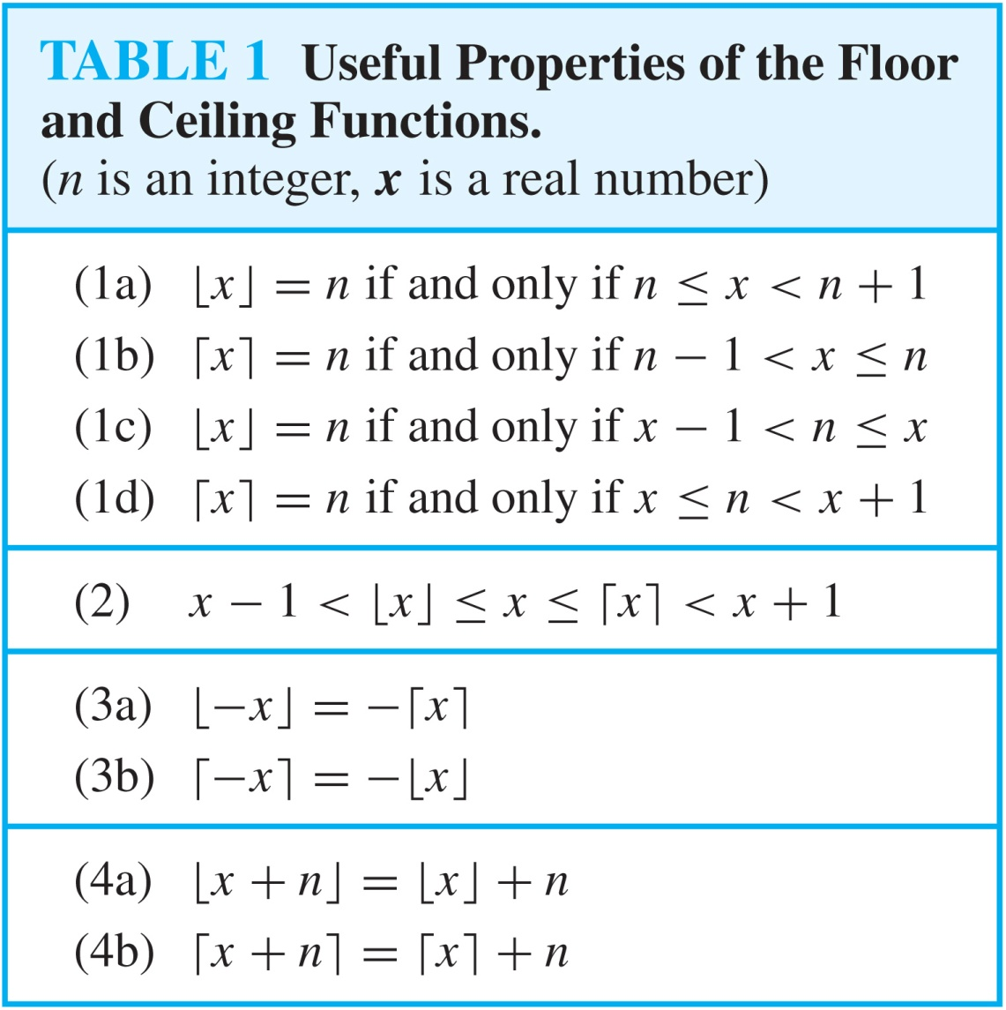
Floor and Ceiling Functions

Slide 77
Proving Properties of Functions
Example: Prove that x is a real number, then
⌊2x⌋= ⌊x⌋ + ⌊x + 1/2⌋
Solution: Let x = n + ε, where n is an integer and 0 ≤ ε< 1.
Case 1: ε < ½
2x = 2n + 2ε and ⌊2x⌋ = 2n, since 0 ≤ 2ε< 1.
⌊x + 1/2⌋ = n, since x + ½ = n + (1/2 + ε ) and 0 ≤ ½ +ε < 1.
Hence, ⌊2x⌋ = 2n and ⌊x⌋ + ⌊x + 1/2⌋ = n + n = 2n.
Case 2: ε ≥ ½
2x = 2n + 2ε = (2n + 1) +(2ε − 1) and ⌊2x⌋ =2n + 1, since 0 ≤ 2 ε - 1< 1.
⌊x + 1/2⌋ = ⌊ n + (1/2 + ε)⌋ = ⌊ n + 1 + (ε – 1/2)⌋ = n + 1 since 0 ≤ ε – 1/2< 1.
Hence, ⌊2x⌋ = 2n + 1 and ⌊x⌋ + ⌊x + 1/2⌋ = n + (n + 1) = 2n + 1.

Slide 78
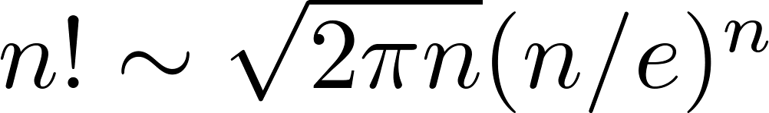
Factorial Function
Definition: f: N → Z⁺ , denoted by f(n) = n! is the product of the first n positive integers when n is a nonnegative integer.
f(n) = 1 ∙ 2 ∙∙∙ (n – 1) ∙ n, f(0) = 0! = 1
Examples:
^{f(1) = 1! = 1}
^{f(2) = 2! = 1 ∙ 2 = 2}
^{f(6) = 6! = 1 ∙ 2 ∙ 3∙ 4∙ 5} ^{∙ 6 = 720}
f(20) = 2,432,902,008,176,640,000.
Stirling’s Formula:

Slide 79
Number Theory and Cryptography
Chapter 4

Slide 80
Chapter Motivation
Number theory is the part of mathematics devoted to the study of the integers and their properties.
Key ideas in number theory include divisibility and the primality of integers.
Number theory has long been studied because of the beauty of its ideas, its accessibility, and its wealth of open questions.
We’ll use many ideas developed in Chapter 1 about proof methods and proof strategy in our exploration of number theory.
Mathematicians have long considered number theory to be pure mathematics, but it has important applications to computer science and cryptography studied in Sections 4.5 and 4.6.

Slide 81
Chapter Summary
Divisibility and Modular Arithmetic
Primes and Greatest Common Divisors
Solving Congruences
Applications of Congruences
Cryptography

Slide 82
Divisibility and Modular Arithmetic
Section 4.1

Slide 83
Section Summary
Division
Division Algorithm
Modular Arithmetic

Slide 84
Division
Definition: If a and b are integers with a ≠ 0, then a divides b if there exists an integer c such that b = ac.
When a divides b we say that a is a factor or divisor of b and that b is a multiple of a.
The notation a | b denotes that a divides b.
If a | b, then b/a is an integer.
If a does not divide b, we write a ∤ b.
Example: Determine whether 3 | 7 and whether 3 | 12.

Slide 85
Properties of Divisibility
Theorem 1: Let a, b, and c be integers, where a ≠0.
If a | b and a | c, then a | (b + c);
If a | b, then a | bc for all integers c;
If a | b and b | c, then a | c.
Proof: (i) Suppose a | b and a | c, then it follows that there are integers s and t with b = as and c = at. Hence,
b + c = as + at = a(s + t). Hence, a | (b + c)
(Exercises 3 and 4 ask for proofs of parts (ii) and (iii).) Corollary: If a, b, and c be integers, where a ≠0, such that a | b and a | c, then a | mb + nc whenever m and n are integers.
Can you show how it follows easily from from (ii) and (i) of Theorem 1?

Slide 86
Division Algorithm
When an integer is divided by a positive integer, there is a quotient and a remainder. This is traditionally called the “Division Algorithm,” but is really a theorem.
Division Algorithm: If a is an integer and d a positive integer, then there are unique integers q and r, with 0 ≤ r < d, such that a = dq + r (proved in Section 5.2).
d is called the divisor.
a is called the dividend.
q is called the quotient.
r is called the remainder.
Examples:
What are the quotient and remainder when 101 is divided by 11?
Solution: The quotient when 101 is divided by 11 is 9 = 101 div 11, and the remainder is 2 = 101 mod 11.
What are the quotient and remainder when −11 is divided by 3?
Solution: The quotient when −11 is divided by 3 is −4 = −11 div 3, and the remainder is 1 = −11 mod 3.
Definitions of Functions div and mod
q = a div d
r = a mod d

Slide 87
Congruence Relation
Definition: If a and b are integers and m is a positive integer, then a is congruent to b modulo m if m divides a – b.
The notation a ≡ b (mod m) says that a is congruent to b modulo m.
We say that a ≡ b (mod m) is a congruence and that m is its modulus.
Two integers are congruent mod m if and only if they have the same remainder when divided by m.
If a is not congruent to b modulo m, we write
a ≢ b (mod m)
Example: Determine whether 17 is congruent to 5 modulo 6 and whether 24 and 14 are congruent modulo 6.
Solution:
17 ≡ 5 (mod 6) because 6 divides 17 − 5 = 12.
24 ≢ 14 (mod 6) since 6 divides 24 − 14 = 10 is not divisible by 6.

Slide 88
More on Congruences
Theorem 4: Let m be a positive integer. The integers a and b are congruent modulo m if and only if there is an integer k such that a = b + km.
Proof:
If a ≡ b (mod m), then (by the definition of congruence) m | a – b. Hence, there is an integer k such that a – b = km and equivalently a = b + km.
Conversely, if there is an integer k such that a = b + km, then km = a – b. Hence, m | a – b and a ≡ b (mod m).

Slide 89
The Relationship between (mod m) and mod m Notations
The use of “mod” in a ≡ b (mod m) and a mod m = b are different.
a ≡ b (mod m) is a relation on the set of integers.
In a mod m = b, the notation mod denotes a function.
The relationship between these notations is made clear in this theorem.
Theorem 3: Let a and b be integers, and let m be a positive integer. Then a ≡ b (mod m) if and only if a mod m = b mod m. (Proof in the exercises)

Slide 90
Congruences of Sums and Products
Let m be a positive integer. If a ≡ b (mod m) and c ≡ d (mod m), then
a + c ≡ b + d (mod m) and ac ≡ bd (mod m)
Example: Because 7 ≡ 2 (mod 5) and 11 ≡ 1 (mod 5) , it follows from Theorem 5 that
18 = 7 + 11 ≡ 2 + 1 = 3 (mod 5)
77 = 7 11 ≡ 2 + 1 = 3 (mod 5)

Slide 91
Algebraic Manipulation of Congruencies
Multiplying both sides of a valid congruence by an integer preserves validity.
If a ≡ b (mod m) holds then c∙a ≡ c∙b (mod m), where c is any integer, holds by Theorem 5 with d = c.
Adding an integer to both sides of a valid congruence preserves validity.
If a ≡ b (mod m) holds then c + a ≡ c + b (mod m), where c is any integer, holds by Theorem 5 with d = c.
Dividing a congruence by an integer does not always produce a valid congruence.
Example: The congruence 14≡ 8 (mod 6) holds. But dividing both sides by 2 does not produce a valid congruence since 14/2 = 7 and 8/2 = 4, but 7≢4 (mod 6).

Slide 92
Computing the mod m Function of Products and Sums
We use the following corollary to Theorem 5 to compute the remainder of the product or sum of two integers when divided by m from the remainders when each is divided by m.
Corollary: Let m be a positive integer and let a and b be integers. Then
(a + b) (mod m) = ((a mod m) + (b mod m)) mod m
and
ab mod m = ((a mod m) (b mod m)) mod m.
(proof in text)

Slide 93
Applications of Congruences

Slide 94
Section Summary
Hashing Functions
Pseudorandom Numbers
Check Digits

Slide 95
Hashing Functions
Definition: A hashing function h assigns memory location h(k) to the record that has k as its key.
A common hashing function is h(k) = k mod m, where m is the number of memory locations.
Because this hashing function is onto, all memory locations are possible.
Example: Let h(k) = k mod 111. This hashing function assigns the records of customers with social security numbers as keys to memory locations in the following manner:
h(064212848) = 064212848 mod 111 = 14
h(037149212) = 037149212 mod 111 = 65
h(107405723) = 107405723 mod 111 = 14, but since location 14 is already occupied, the record is assigned to the next available position, which is 15.
The hashing function is not one-to-one as there are many more possible keys than memory locations. When more than one record is assigned to the same location, we say a collision occurs. Here a collision has been resolved by assigning the record to the first free location.
For collision resolution, we can use a linear probing function:
h(k,i) = (h(k) + i) mod m, where i runs from 0 to m − 1.
There are many other methods of handling with collisions. You may cover these in a
later CS course.

Slide 96
Pseudorandom Numbers
Randomly chosen numbers are needed for many purposes, including computer simulations.
Pseudorandom numbers are not truly random since they are generated by systematic methods.
The linear congruential method is one commonly used procedure for generating pseudorandom numbers.
Four integers are needed: the modulus m, the multiplier a, the increment c, and seed x₀, with 2 ≤ a < m, 0 ≤ c < m, 0 ≤ x₀ < m.
We generate a sequence of pseudorandom numbers {x_{n}}, with 0 ≤ x_{n} < m for all n, by successively using the recursively defined function
(an example of a recursive definition, discussed in Section 5.3)
If psudorandom numbers between 0 and 1 are needed, then the generated numbers are divided by the modulus, x_{n} /m.
x_{n+1} = (ax_{n} + c) mod m.

Slide 97
Pseudorandom Numbers
Example: Find the sequence of pseudorandom numbers generated by the linear congruential method with modulus m = 9, multiplier a = 7, increment c = 4, and seed x₀ = 3.
Solution: Compute the terms of the sequence by successively using the congruence x_{n+1} = (7x_{n} + 4) mod 9, with x₀ = 3.
x₁ = 7x₀ + 4 mod 9 = 7∙3 + 4 mod 9 = 25 mod 9 = 7,
x₂ = 7x₁ + 4 mod 9 = 7∙7 + 4 mod 9 = 53 mod 9 = 8,
x₃ = 7x₂ + 4 mod 9 = 7∙8 + 4 mod 9 = 60 mod 9 = 6,
x₄ = 7x₃ + 4 mod 9 = 7∙6 + 4 mod 9 = 46 mod 9 = 1,
x₅ = 7x₄ + 4 mod 9 = 7∙1 + 4 mod 9 = 11 mod 9 = 2,
x₆ = 7x₅ + 4 mod 9 = 7∙2 + 4 mod 9 = 18 mod 9 = 0,
x₇ = 7x₆ + 4 mod 9 = 7∙0 + 4 mod 9 = 4 mod 9 = 4,
x₈ = 7x₇ + 4 mod 9 = 7∙4 + 4 mod 9 = 32 mod 9 = 5,
x₉ = 7x₈ + 4 mod 9 = 7∙5 + 4 mod 9 = 39 mod 9 = 3.
The sequence generated is 3,7,8,6,1,2,0,4,5,3,7,8,6,1,2,0,4,5,3,…
It repeats after generating 9 terms.
Commonly, computers use a linear congruential generator with increment c = 0. This is called a pure multiplicative generator. Such a generator with modulus 2³¹ − 1 and multiplier 7⁵ = 16,807 generates 2³¹ − 2 numbers before repeating.

Slide 98
Check Digits: UPCs
A common method of detecting errors in strings of digits is to add an extra digit at the end, which is evaluated using a function. If the final digit is not correct, then the string is assumed not to be correct.
Example: Retail products are identified by their Universal Product Codes (UPCs). Usually these have 12 decimal digits, the last one being the check digit. The check digit is determined by the congruence:
3x₁ + x₂ + 3x₃ + x₄ + 3x₅ + x₆ + 3x₇ + x₈ + 3x₉ + x₁₀ + 3x₁₁ + x₁₂ ≡ 0 (mod 10).
Suppose that the first 11 digits of the UPC are 79357343104. What is the check digit?
Is 041331021641 a valid UPC?
Solution:
3∙7 + 9 + 3∙3 + 5 + 3∙7 + 3 + 3∙4 + 3 + 3∙1 + 0 + 3∙4 + x₁₂ ≡ 0 (mod 10)
21 + 9 + 9 + 5 + 21 + 3 + 12+ 3 + 3 + 0 + 12 + x₁₂ ≡ 0 (mod 10)
98 + x₁₂ ≡ 0 (mod 10)
x₁₂ ≡ 0 (mod 10) So, the check digit is 2.
3∙0 + 4 + 3∙1 + 3 + 3∙3 + 1 + 3∙0 + 2 + 3∙1 + 6 + 3∙4 + 1 ≡ 0 (mod 10)
0 + 4 + 3 + 3 + 9 + 1 + 0+ 2 + 3 + 6 + 12 + 1 = 44 ≡ 4 ≢ (mod 10)
Hence, 041331021641 is not a valid UPC.

Slide 99
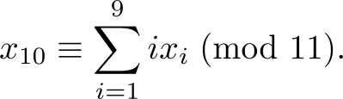

Check Digits:ISBNs
Books are identified by an International Standard Book Number (ISBN-10), a 10 digit code. The first 9 digits identify the language, the publisher, and the book. The tenth digit is a check digit, which is determined by the following congruence
The validity of an ISBN-10 number can be evaluated with the equivalent
Suppose that the first 9 digits of the ISBN-10 are 007288008. What is the check digit?
Is 084930149X a valid ISBN10?
Solution:
a. X₁₀ ≡ 1∙0 + 2∙0 + 3∙7 + 4∙2 + 5∙8 + 6∙8 + 7∙ 0 + 8∙0 + 9∙8 (mod 11).
X₁₀ ≡ 0 + 0 + 21 + 8 + 40 + 48 + 0 + 0 + 72 (mod 11).
X₁₀ ≡ 189 ≡ 2 (mod 11). Hence, X₁₀ = 2.
b. 1∙0 + 2∙8 + 3∙4 + 4∙9 + 5∙3 + 6∙0 + 7∙ 1 + 8∙4 + 9∙9 + 10∙10 =
0 + 16 + 12 + 36 + 15 + 0 + 7 + 32 + 81 + 100 = 299 ≡ 2 ≢ 0 (mod 11)
Hence, 084930149X is not a valid ISBN-10.
A single error is an error in one digit of an identification number and a transposition error is the accidental interchanging of two digits. Both of these kinds of errors can be detected by the check digit for ISBN-10. (see text for more details)
X is used for the digit 10.

Slide 100
Cryptography

Slide 101
Section Summary
Classical Cryptography
Cryptosystems
Public Key Cryptography
RSA Cryptosystem
Crytographic Protocols
Primitive Roots and Discrete Logarithms

Slide 102
Caesar Cipher
Julius Caesar created secret messages by shifting each letter three letters forward in the alphabet (sending the last three letters to the first three letters.) For example, the letter B is replaced by E and the letter X is replaced by A. This process of making a message secret is an example of encryption.
Here is how the encryption process works:
Replace each letter by an integer from Z₂₆, that is an integer from 0 to 25 representing one less than its position in the alphabet.
The encryption function is f(p) = (p + 3) mod 26. It replaces each integer p in the set {0,1,2,…,25} by f(p) in the set {0,1,2,…,25} .
Replace each integer p by the letter with the position p + 1 in the alphabet.
Example: Encrypt the message “MEET YOU IN THE PARK” using the Caesar cipher.
Solution: 12 4 4 19 24 14 20 8 13 19 7 4 15 0 17 10.
Now replace each of these numbers p by f(p) = (p + 3) mod 26.
15 7 7 22 1 17 23 11 16 22 10 7 18 3 20 13.
Translating the numbers back to letters produces the encrypted message
“PHHW BRX LQ WKH SDUN.”

Slide 103
Caesar Cipher
To recover the original message, use f⁻¹(p) = (p−3) mod 26. So, each letter in the coded message is shifted back three letters in the alphabet, with the first three letters sent to the last three letters. This process of recovering the original message from the encrypted message is called decryption.
The Caesar cipher is one of a family of ciphers called shift ciphers. Letters can be shifted by an integer k, with 3 being just one possibility. The encryption function is
f(p) = (p + k) mod 26
and the decryption function is
f⁻¹(p) = (p−k) mod 26
The integer k is called a key.

Slide 104
Shift Cipher
Example 1: Encrypt the message “STOP GLOBAL WARMING” using the shift cipher with k = 11.
Solution: Replace each letter with the corresponding element of Z₂₆.
18 19 14 15 6 11 14 1 0 11 22 0 17 12 8 13 6.
Apply the shift f(p) = (p + 11) mod 26, yielding
3 4 25 0 17 22 25 12 11 22 7 11 2 23 19 24 17.
Translating the numbers back to letters produces the ciphertext
“DEZA RWZMLW HLCXTYR.”

Slide 105
Shift Cipher
Example 2: Decrypt the message “LEWLYPLUJL PZ H NYLHA ALHJOLY” that was encrypted using the shift cipher with k = 7.
Solution: Replace each letter with the corresponding element of Z₂₆.
11 4 22 11 24 15 11 20 9 11 15 25 7 13 24 11 7 0 0 11 7 9 14 11 24.
Shift each of the numbers by −k = −7 modulo 26, yielding
4 23 15 4 17 8 4 13 2 4 8 18 0 6 17 4 0 19 19 4 0 2 7 4 17.
Translating the numbers back to letters produces the decrypted message
“EXPERIENCE IS A GREAT TEACHER.”

Slide 106
Arithmetic Modulo m
Definitions: Let Z_{m} be the set of nonnegative integers less than m: {0,1, …., m−1}
The operation +_{m} is defined as a +_{m} b = (a + b) mod m. This is addition modulo m.
The operation ∙_{m} is defined as a ∙_{m} b = (a . b) mod m. This is multiplication modulo m.
Using these operations is said to be doing arithmetic modulo m.
Example: Find 7 +₁₁ 9 and 7 ∙₁₁ 9.
Solution: Using the definitions above:
7 +₁₁ 9 = (7 + 9) mod 11 = 16 mod 11 = 5
7 ∙₁₁ 9 = (7 ∙ 9) mod 11 = 63 mod 11 = 8

Slide 107
Arithmetic Modulo m
The operations +_{m} and ∙_{m} satisfy many of the same properties as ordinary addition and multiplication.
Closure: If a and b belong to Z_{m} , then a +_{m} b and a ∙_{m} b belong to Z_{m} .
Associativity: If a, b, and c belong to Z_{m} , then (a +_{m} b) +_{m} c = a +_{m} (b +_{m} c) and (a ∙_{m} b) ∙_{m} c = a ∙_{m} (b ∙_{m} c).
Commutativity: If a and b belong to Z_{m} , then a +_{m} b = b +_{m} a and a ∙_{m} b = b ∙_{m} a.
Identity elements: The elements 0 and 1 are identity elements for addition and multiplication modulo m, respectively.
If a belongs to Z_{m} , then a +_{m} 0 = a and a ∙_{m} 1 = a.
continued →

Slide 108
Arithmetic Modulo m
Additive inverses: If a≠ 0 belongs to Z_{m} , then m− a is the additive inverse of a modulo m and 0 is its own additive inverse.
a +_{m} (m− a ) = 0 and 0 +_{m} 0 = 0
Distributivity: If a, b, and c belong to Z_{m} , then
a ∙_{m} (b +_{m} c) = (a ∙_{m} b) +_{m} (a ∙_{m} c) and (a +_{m} b) ∙_{m} c = (a ∙_{m} c) +_{m} (b ∙_{m} c).
Exercises 42-44 ask for proofs of these properties.
Multiplicatative inverses have not been included since they do not always exist. For example, there is no multiplicative inverse of 2 modulo 6.
(optional) Using the terminology of abstract algebra, Z_{m} with +_{m} is a commutative group and Z_{m} with +_{m} and ∙_{m} is a commutative ring.

Slide 109
Primes and Greatest Common Divisors
Section 4.3

Slide 110
Section Summary
Prime Numbers and their Properties
Conjectures and Open Problems About Primes
Greatest Common Divisors and Least Common Multiples
The Euclidian Algorithm
gcds as Linear Combinations

Slide 111
Primes
Definition: A positive integer p greater than 1 is called prime if the only positive factors of p are 1 and p. A positive integer that is greater than 1 and is not prime is called composite.
Example: The integer 7 is prime because its only positive factors are 1 and 7, but 9 is composite because it is divisible by 3.

Slide 112
The Fundamental Theorem of Arithmetic
Theorem: Every positive integer greater than 1 can be written uniquely as a prime or as the product of two or more primes where the prime factors are written in order of nondecreasing size.
Examples:
100 = 2 ∙ 2 ∙ 5 ∙ 5 = 2² ∙ 5²
641 = 641
999 = 3 ∙ 3 ∙ 3 ∙ 37 = 3³ ∙ 37
1024 = 2 ∙ 2 ∙ 2 ∙ 2 ∙ 2 ∙ 2 ∙ 2 ∙ 2 ∙ 2 ∙ 2 = 2¹⁰

Slide 113
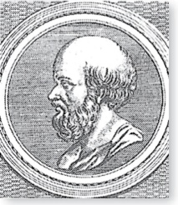
The Sieve of Erastosthenes
Erastothenes
(276-194 B.C.)
The Sieve of Erastosthenes can be used to find all primes not exceeding a specified positive integer. For example, begin with the list of integers between 1 and 100.
Delete all the integers, other than 2, divisible by 2.
Delete all the integers, other than 3, divisible by 3.
Next, delete all the integers, other than 5, divisible by 5.
Next, delete all the integers, other than 7, divisible by 7.
Since all the remaining integers are not divisible by any of the previous integers, other than 1, the primes are:
{2,3,7,11,19,23,29,31,37,41,43,47,53,59,61,67,71,73,79,83,89, 97}
continued →

Slide 114
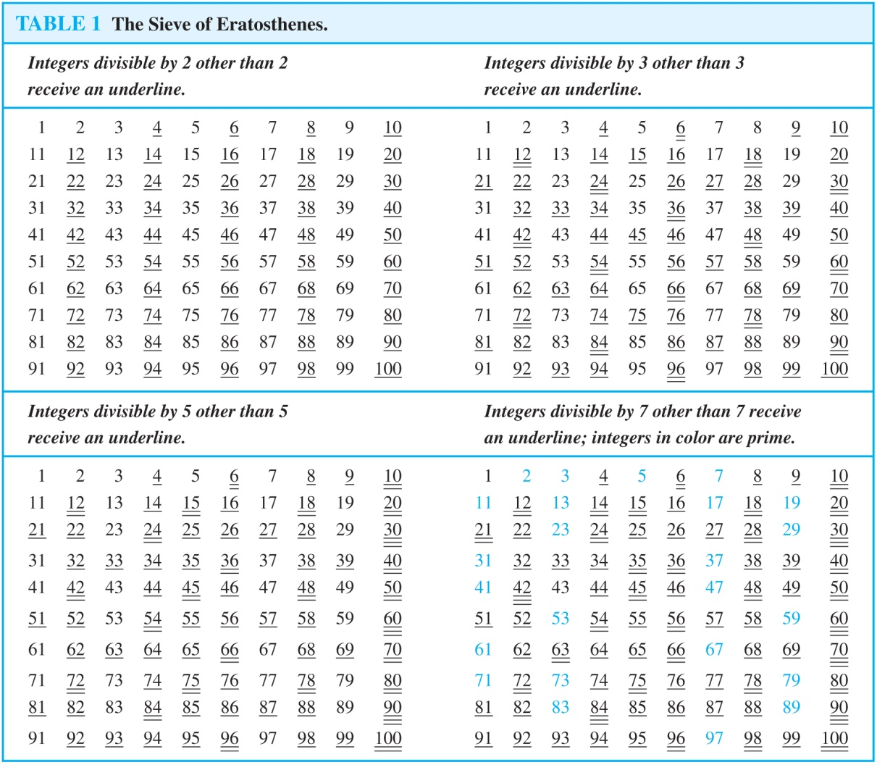
The Sieve of Erastosthenes
If an integer n is a composite integer, then it has a prime divisor less than or equal to √n.
To see this, note that if n = ab, then a ≤ √n or b ≤√n.
Trial division, a very inefficient method of determining if a number n is prime, is to try every integer i ≤√n and see if n is divisible by i.

Slide 115
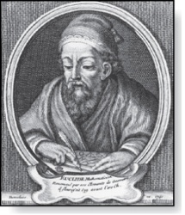

Infinitude of Primes
Euclid
(325 B.C.E. – 265 B.C.E.)
Theorem: There are infinitely many primes. (Euclid)
Proof: Assume finitely many primes: p₁, p₂, ….., p_{n}
Let q = p₁p₂∙∙∙ p_{n} + 1
Either q is prime or by the fundamental theorem of arithmetic it is a product of primes.
But none of the primes p_{j} divides q since if p_{j} | q, then p_{j} divides q − p₁p₂∙∙∙ p_{n} = 1 .
Hence, there is a prime not on the list p₁, p₂, ….., p_{n}. It is either q, or if q is composite, it is a prime factor of q. This contradicts the assumption that p₁, p₂, ….., p_{n} are all the primes.
Consequently, there are infinitely many primes.
This proof was given by Euclid The Elements. The proof is considered to be one of the most beautiful in all mathematics. It is the first proof in The Book, inspired by the famous mathematician Paul Erdős’ imagined collection of perfect proofs maintained by God.
Paul Erdős
(1913-1996)

Slide 116
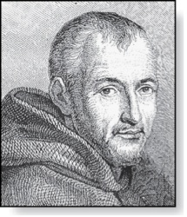
Mersenne Primes
Marin Mersenne
(1588-1648)
Definition: Prime numbers of the form 2^{p} − 1 , where p is prime, are called Mersenne primes.
2² − 1 = 3, 2³ − 1 = 7, 2⁵ − 1 = 37 , and 2⁷ − 1 = 127 are Mersenne primes.
2¹¹ − 1 = 2047 is not a Mersenne prime since 2047 = 23∙89.
There is an efficient test for determining if 2^{p} − 1 is prime.
The largest known prime numbers are Mersenne primes.
As of mid 2011, 47 Mersenne primes were known, the largest is 2^{43,112,609} − 1, which has nearly 13 million decimal digits.
The Great Internet Mersenne Prime Search (GIMPS) is a distributed computing project to search for new Mersenne Primes.
http://www.mersenne.org/

Slide 117
Greatest Common Divisor
Definition: Let a and b be integers, not both zero. The largest integer d such that d | a and also d | b is called the greatest common divisor of a and b. The greatest common divisor of a and b is denoted by gcd(a,b).
One can find greatest common divisors of small numbers by inspection.
Example:What is the greatest common divisor of 24 and 36?
Solution: gcd(24,36) = 12
Example:What is the greatest common divisor of 17 and 22?
Solution: gcd(17,22) = 1

Slide 118
Greatest Common Divisor
Definition: The integers a and b are relatively prime if their greatest common divisor is 1.
Example: 17 and 22
Definition: The integers a₁, a₂, …, a_{n} are pairwise relatively prime if gcd(a_{i}, a_{j})= 1 whenever 1 ≤ i<j ≤n.
Example: Determine whether the integers 10, 17 and 21 are pairwise relatively prime.
Solution: Because gcd(10,17) = 1, gcd(10,21) = 1, and gcd(17,21) = 1, 10, 17, and 21 are pairwise relatively prime.
Example: Determine whether the integers 10, 19, and 24 are pairwise relatively prime.
Solution: Because gcd(10,24) = 2, 10, 19, and 24 are not pairwise relatively prime.

Slide 119
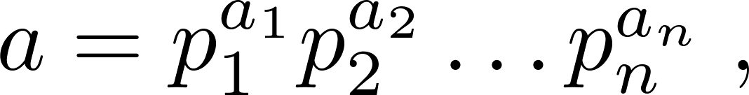
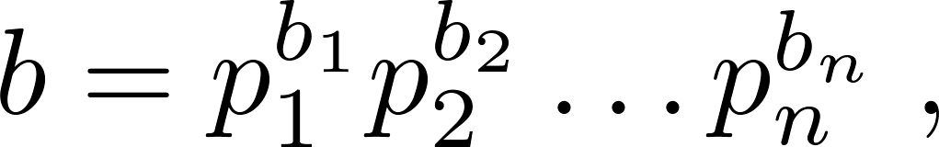
Finding the Greatest Common Divisor Using Prime Factorizations
Suppose the prime factorizations of a and b are:
where each exponent is a nonnegative integer, and where all primes occurring in either prime factorization are included in both. Then:
This formula is valid since the integer on the right (of the equals sign) divides both a and b. No larger integer can divide both a and b.
Example: 120 = 2³ ∙3 ∙5 500 = 2² ∙5³
gcd(120,500) = 2^{min(3,2)} ∙3^{min(1,0)} ∙5^{min(1,3)} = 2² ∙3⁰ ∙5¹ = 20
Finding the gcd of two positive integers using their prime factorizations is not efficient because there is no efficient algorithm for finding the prime factorization of a positive integer.

Slide 120
Least Common Multiple
Definition: The least common multiple of the positive integers a and b is the smallest positive integer that is divisible by both a and b. It is denoted by lcm(a,b).
The least common multiple can also be computed from the prime factorizations.
This number is divided by both a and b and no smaller number is divided by a and b.
Example: lcm(2³3⁵7², 2⁴3³) = 2^{max(3,4)} 3^{max(5,3)} 7^{max(2,0)} = 2⁴ 3⁵ 7²
The greatest common divisor and the least common multiple of two integers are related by:
Theorem 5: Let a and b be positive integers. Then
ab = gcd(a,b) ∙lcm(a,b)
(proof is Exercise 31)

Slide 121
Euclidean Algorithm
Euclid
(325 B.C.E. – 265 B.C.E.)
The Euclidian algorithm is an efficient method for computing the greatest common divisor of two integers. It is based on the idea that gcd(a,b) is equal to gcd(a,c) when a > b and c is the remainder when a is divided by b.
Example: Find gcd(91, 287):
287 = 91 ∙ 3 + 14
91 = 14 ∙ 6 + 7
14 = 7 ∙ 2 + 0
gcd(287, 91) = gcd(91, 14) = gcd(14, 7) = 7
Divide 287 by 91
Divide 91 by 14
Divide 14 by 7
Stopping condition
continued →

Slide 122
Euclidean Algorithm
The Euclidean algorithm expressed in pseudocode is:
In Section 5.3, we’ll see that the time complexity of the algorithm is O(log b), where a > b.
procedure gcd(a, b: positive integers)
x := a
x := b
while y ≠ 0
r := x mod y
x := y
y := r
return x {gcd(a,b) is x}

Slide 123
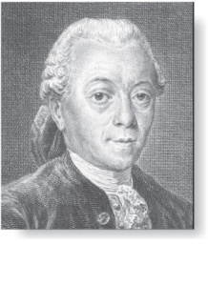
gcds as Linear Combinations
Étienne Bézout
(1730-1783)
Bézout’s Theorem: If a and b are positive integers, then there exist integers s and t such that gcd(a,b) = sa + tb.
(proof in exercises of Section 5.2)
Definition: If a and b are positive integers, then integers s and t such that gcd(a,b) = sa + tb are called Bézout coefficients of a and b. The equation gcd(a,b) = sa + tb is called Bézout’s identity.
By Bézout’s Theorem, the gcd of integers a and b can be expressed in the form sa + tb where s and t are integers. This is a linear combination with integer coefficients of a and b.
gcd(6,14) = (−2)∙6 + 1∙14

Slide 124
Finding gcds as Linear Combinations
Example: Express gcd(252,198) = 18 as a linear combination of 252 and 198.
Solution: First use the Euclidean algorithm to show gcd(252,198) = 18
252 = 1∙198 + 54
198 = 3 ∙54 + 36
54 = 1 ∙36 + 18
36 = 2 ∙18
Now working backwards, from iii and i above
18 = 54 − 1 ∙36
36 = 198 − 3 ∙54
Substituting the 2nd equation into the 1st yields:
18 = 54 − 1 ∙(198 − 3 ∙54 )= 4 ∙54 − 1 ∙198
Substituting 54 = 252 − 1 ∙198 (from i)) yields:
18 = 4 ∙(252 − 1 ∙198) − 1 ∙198 = 4 ∙252 − 5 ∙198
This method illustrated above is a two pass method. It first uses the Euclidian algorithm to find the gcd and then works backwards to express the gcd as a linear combination of the original two integers. A one pass method, called the extended Euclidean algorithm, is developed in the exercises.

Slide 125
Dividing Congruences by an Integer
Dividing both sides of a valid congruence by an integer does not always produce a valid congruence (see Section 4.1).
But dividing by an integer relatively prime to the modulus does produce a valid congruence:
Theorem 7: Let m be a positive integer and let a, b, and c be integers. If ac ≡ bc (mod m) and gcd(c,m) = 1, then a ≡ b (mod m).
Proof: Since ac ≡ bc (mod m), m | ac − bc = c(a − b) by Lemma 2 and the fact that gcd(c,m) = 1, it follows that m | a − b. Hence, a ≡ b (mod m).

Slide 126
Solving Congruences
Section 4.4

Slide 127
Section Summary
Linear Congruences
The Chinese Remainder Theorem
Fermat’s Little Theorem
Pseudoprimes

Slide 128
Linear Congruences
Definition: A congruence of the form
ax ≡ b( mod m),
where m is a positive integer, a and b are integers, and x is a variable, is called a linear congruence.
The solutions to a linear congruence ax≡ b( mod m) are all integers x that satisfy the congruence.
Definition: An integer ā such that āa ≡ 1( mod m) is said to be an inverse of a modulo m.
Example: 5 is an inverse of 3 modulo 7 since 5∙3 = 15 ≡ 1(mod 7)
One method of solving linear congruences makes use of an inverse ā, if it exists. Although we can not divide both sides of the congruence by a, we can multiply by ā to solve for x.

Slide 129
Inverse of a modulo m
The following theorem guarantees that an inverse of a modulo m exists whenever a and m are relatively prime. Two integers a and b are relatively prime when gcd(a,b) = 1.
Theorem 1: If a and m are relatively prime integers and m > 1, then an inverse of a modulo m exists. Furthermore, this inverse is unique modulo m. (This means that there is a unique positive integer ā less than m that is an inverse of a modulo m and every other inverse of a modulo m is congruent to ā modulo m.)
Proof: Since gcd(a,m) = 1, by Theorem 6 of Section 4.3, there are integers s and t such that sa + tm = 1.
Hence, sa + tm ≡ 1 ( mod m).
Since tm ≡ 0 ( mod m), it follows that sa ≡ 1 ( mod m)
Consequently, s is an inverse of a modulo m.
The uniqueness of the inverse is Exercise 7.

Slide 130
Finding Inverses
The Euclidean algorithm and Bézout coefficients gives us a systematic approaches to finding inverses.
Example: Find an inverse of 3 modulo 7.
Solution: Because gcd(3,7) = 1, by Theorem 1, an inverse of 3 modulo 7 exists.
Using the Euclidian algorithm: 7 = 2∙3 + 1.
From this equation, we get −2∙3 + 1∙7 = 1, and see that −2 and 1 are Bézout coefficients of 3 and 7.
Hence, −2 is an inverse of 3 modulo 7.
Also every integer congruent to −2 modulo 7 is an inverse of 3 modulo 7, i.e., 5, −9, 12, etc.

Slide 131
Finding Inverses
Example: Find an inverse of 101 modulo 4620.
Solution: First use the Euclidian algorithm to show that gcd(101,4620) = 1.
Working Backwards:
42620 = 45∙101 + 75
101 = 1∙75 + 26
75 = 2∙26 + 23
26 = 1∙23 + 3
23 = 7∙3 + 2
3 = 1∙2 + 1
2 = 2∙1
1 = 3 − 1∙2
1 = 3 − 1∙(23 − 7∙3) = − 1 ∙23 + 8∙3
1 = −1∙23 + 8∙(26 − 1∙23) = 8∙26 − 9 ∙23
1 = 8∙26 − 9 ∙(75 − 2∙26 )= 26∙26 − 9 ∙75
1 = 26∙(101 − 1∙75) − 9 ∙75
= 26∙101 − 35 ∙75
1 = 26∙101 − 35 ∙(42620 − 45∙101)
= − 35 ∙42620 + 1601∙101
Since the last nonzero
remainder is 1,
gcd(101,4260) = 1
Bézout coefficients : − 35 and 1601
1601 is an inverse of 101 modulo 42620

Slide 132
Using Inverses to Solve Congruences
We can solve the congruence ax≡ b( mod m) by multiplying both sides by ā.
Example: What are the solutions of the congruence 3x≡ 4( mod 7).
Solution: We found that −2 is an inverse of 3 modulo 7 (two slides back). We multiply both sides of the congruence by −2 giving
−2 ∙ 3x ≡ −2 ∙ 4(mod 7).
Because −6 ≡ 1 (mod 7) and −8 ≡ 6 (mod 7), it follows that if x is a solution, then x ≡ −8 ≡ 6 (mod 7)
We need to determine if every x with x ≡ 6 (mod 7) is a solution. Assume that x ≡ 6 (mod 7). By Theorem 5 of Section 4.1, it follows that 3x ≡ 3 ∙ 6 = 18 ≡ 4( mod 7) which shows that all such x satisfy the congruence.
The solutions are the integers x such that x ≡ 6 (mod 7), namely, 6,13,20 … and −1, − 8, − 15,…

Slide 133
The Chinese Remainder Theorem
Theorem 2: (The Chinese Remainder Theorem) Let m₁,m₂,…,m_{n} be pairwise relatively prime positive integers greater than one and a₁,a₂,…,a_{n} arbitrary integers. Then the system
x ≡ a₁ ( mod m₁)
x ≡ a₂ ( mod m₂)
∙
∙
∙
x ≡ a_{n} ( mod m_{n})
has a unique solution modulo m = m₁m₂ ∙ ∙ ∙ m_{n}.
(That is, there is a solution x with 0 ≤ x <m and all other solutions are congruent modulo m to this solution.)
Proof: We’ll show that a solution exists by describing a way to construct the solution. Showing that the solution is unique modulo m is Exercise 30.
continued →

Slide 134
The Chinese Remainder Theorem
To construct a solution first let M_{k}=m/m_{k} for k = 1,2,…,n and m = m₁m₂ ∙ ∙ ∙ m_{n}.
Since gcd(m_{k} ,M_{k} ) = 1, by Theorem 1, there is an integer y_{k} , an inverse of M_{k} modulo m_{k}, such that
M_{k} y_{k} ≡ 1 ( mod m_{k} ).
Form the sum
x = a₁ M₁ y₁ + a₂ M₂ y₂ + ∙ ∙ ∙ + a_{n} M_{n} y_{n} .
Note that because M_{j} ≡ 0 ( mod m_{k}) whenever j ≠k , all terms except the kth term in this sum are congruent to 0 modulo m_{k} .
Because M_{k} y_{k} ≡ 1 ( mod m_{k} ), we see that x ≡ a_{k} M_{k} y_{k} ≡ a_{k}( mod m_{k}), for k = 1,2,…,n.
Hence, x is a simultaneous solution to the n congruences.
x ≡ a₁ ( mod m₁)
x ≡ a₂ ( mod m₂)
∙
∙
∙
x ≡ a_{n} ( mod m_{n})

Slide 135
The Chinese Remainder Theorem
Example: Consider the 3 congruences from Sun-Tsu’s problem:
x ≡ 2 ( mod 3), x ≡ 3 ( mod 5), x ≡ 2 ( mod 7).
Let m = 3∙ 5 ∙ 7 = 105, M₁ = m/3 = 35, M₃ = m/5 = 21, M₃ = m/7 = 15.
We see that
2 is an inverse of M₁ = 35 modulo 3 since 35 ∙ 2 ≡ 2 ∙ 2 ≡ 1 (mod 3)
1 is an inverse of M₂ = 21 modulo 5 since 21 ≡ 1 (mod 5)
1 is an inverse of M₃ = 15 modulo 7 since 15 ≡ 1 (mod 7)
Hence,
x = a₁M₁y₁ + a₂M₂y₂ + a₃M₃y₃
= 2 ∙ 35 ∙ 2 + 3 ∙ 21 ∙ 1 + 2 ∙ 15 ∙ 1 = 233 ≡ 23 (mod 105)
We have shown that 23 is the smallest positive integer that is a simultaneous solution. Check it!

Slide 136
Problem:
Jessica breeds rabbits. She's not sure exactly how many she has today, but as she was moving them about this morning, she noticed some things. When she fed them, in groups of 5, she had 4 left over. When she bathed them, in groups of 8, she had a group of 6 left over. She took them outside to romp in groups of 9, but then the last group consisted of only 8. She's positive that there are fewer than 250 rabbits - but how many does she have?

Slide 137
Back Substitution
We can also solve systems of linear congruences with pairwise relatively prime moduli by rewriting a congruences as an equality using Theorem 4 in Section 4.1, substituting the value for the variable into another congruence, and continuing the process until we have worked through all the congruences. This method is known as back substitution.
Example: Use the method of back substitution to find all integers x such that x ≡ 1 (mod 5), x ≡ 2 (mod 6), and x ≡ 3 (mod 7).
Solution: By Theorem 4 in Section 4.1, the first congruence can be rewritten as x = 5t +1, where t is an integer.
Substituting into the second congruence yields 5t +1 ≡ 2 (mod 6).
Solving this tells us that t ≡ 5 (mod 6).
Using Theorem 4 again gives t = 6u + 5 where u is an integer.
Substituting this back into x = 5t +1, gives x = 5(6u + 5) +1 = 30u + 26.
Inserting this into the third equation gives 30u + 26 ≡ 3 (mod 7).
Solving this congruence tells us that u ≡ 6 (mod 7).
By Theorem 4, u = 7v + 6, where v is an integer.
Substituting this expression for u into x = 30u + 26, tells us that x = 30(7v + 6) + 26 = 210u + 206.
Translating this back into a congruence we find the solution x ≡ 206 (mod 210).

Slide 138

Fermat’s Little Theorem
Pierre de Fermat
(1601-1665)
Theorem 3: (Fermat’s Little Theorem) If p is prime and a is an integer not divisible by p, then a^{p-1} ≡ 1 (mod p)
Furthermore, for every integer a we have a^{p} ≡ a (mod p)
(proof outlined in Exercise 19)
Fermat’s little theorem is useful in computing the remainders modulo p of large powers of integers.
Example: Find 7²²² mod 11.
By Fermat’s little theorem, we know that 7¹⁰ ≡ 1 (mod 11), and so (7¹⁰ )^{k} ≡ 1 (mod 11), for every positive integer k. Therefore,
7²²² = 7^{22∙10 + 2} = (7¹⁰)²²7² ≡ (1)²² ∙49 ≡ 5 (mod 11).
Hence, 7²²² mod 11 = 5.

Slide 139
Pseudoprimes
By Fermat’s little theorem n > 2 is prime, where
2^{n-1} ≡ 1 (mod n).
But if this congruence holds, n may not be prime. Composite integers n such that 2^{n-1} ≡ 1 (mod n) are called pseudoprimes to the base 2.
Example: The integer 341 is a pseudoprime to the base 2.
341 = 11 ∙ 31
2³⁴⁰ ≡ 1 (mod 341) (see in Exercise 37)
We can replace 2 by any integer b ≥ 2.
Definition: Let b be a positive integer. If n is a composite integer, and b^{n-1} ≡ 1 (mod n), then n is called a pseudoprime to the base b.

Slide 140
Pseudoprimes
Given a positive integer n, such that 2^{n-1} ≡ 1 (mod n):
If n does not satisfy the congruence, it is composite.
If n does satisfy the congruence, it is either prime or a pseudoprime to the base 2.
Doing similar tests with additional bases b, provides more evidence as to whether n is prime.
Among the positive integers not exceeding a positive real number x, compared to primes, there are relatively few pseudoprimes to the base b.
For example, among the positive integers less than 10¹⁰ there are 455,052,512 primes, but only 14,884 pseudoprimes to the base 2.

